Slide 1
Divided Difference
NAZMUL KADER CHOWDHURY

Slide 2
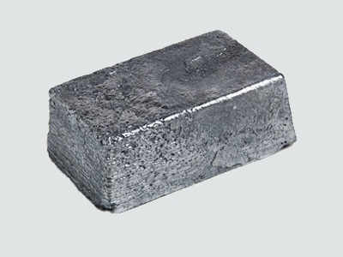
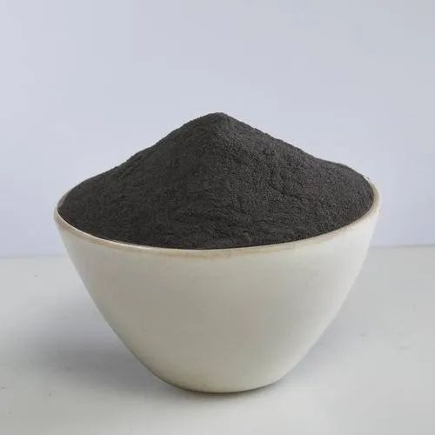
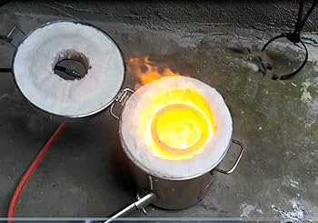

POLYNOMIALS
LAGRANGE OR DIVIDED DIFFERENCE

Slide 5
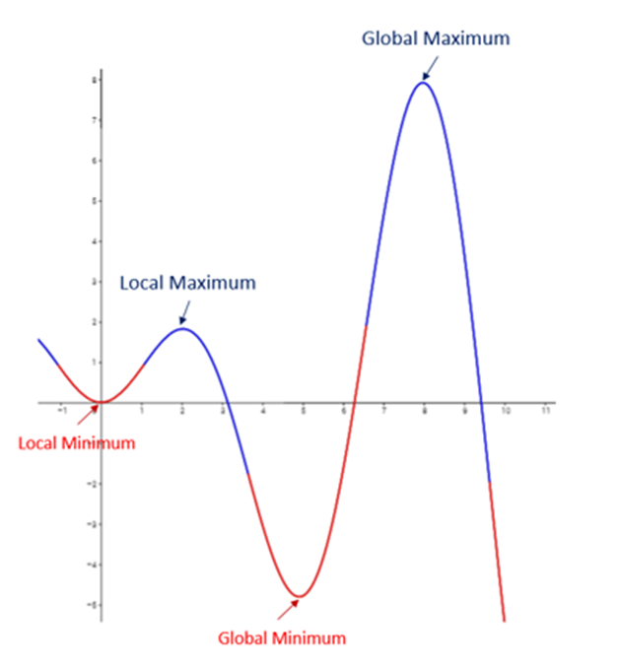
Maxima and Minima

Slide 6
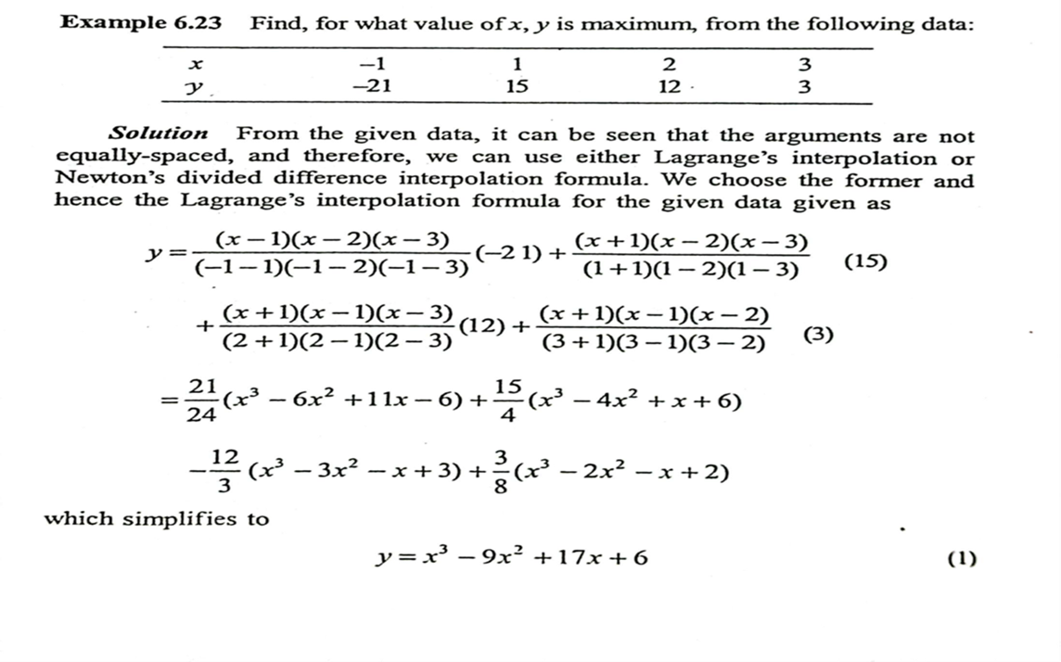

Slide 7
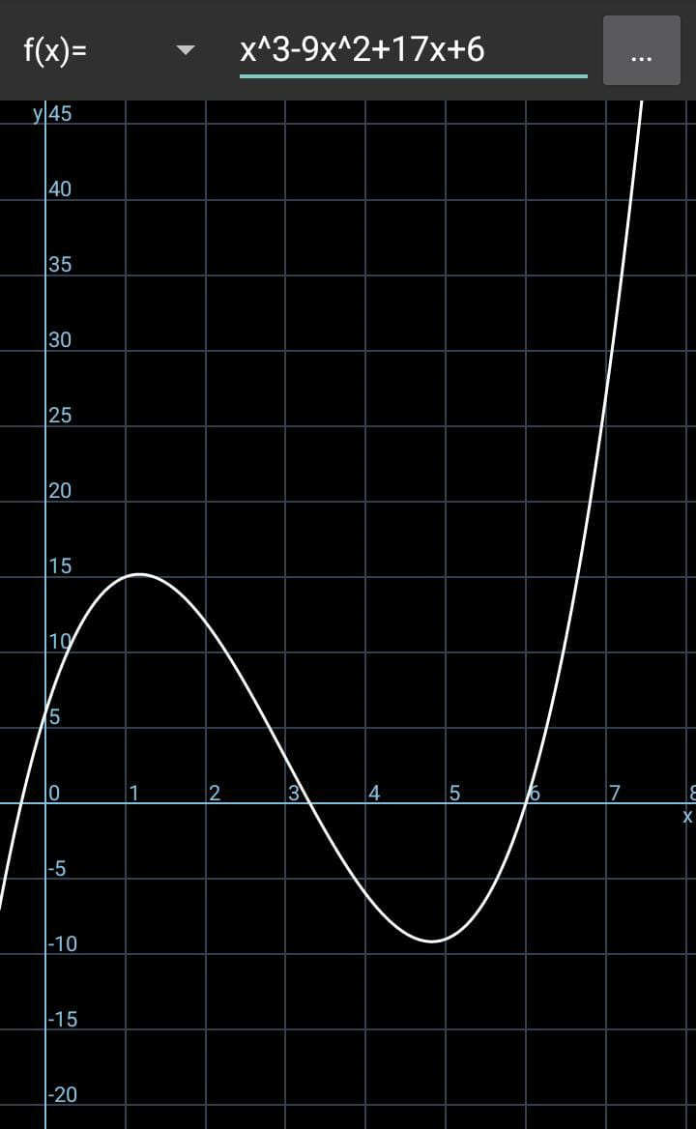

Slide 8
STEP 1 :FIND THE LOCATION
STEP 2: TEST THE LOCATION
STEP 3: FIND THE VALUE

Slide 10
1) Find the interpolating polynomial by 1) divided difference formula 2) Lagrange’s formula for the following data show that both methods give rise to the same polynomial.
X | 1 | 2 | 23 | 5
y | 0 | 7 | 26 | 124
2) Find the missing values in the following table
X | 0 | 1 | 2 | 3 | 4 | 5 | 6
Y | -4 | -2 | - | - | 220 | 546 | 1148
3) Find for what value of x,y is maximum, from the following data
X | -1 | 1 | 2 | 3 | 3
y | -19 | 17 | 14 | 5 | -4
4) Find the equation of cubic which passes through point using divided difference formula
X | 4 | 7 | 9 | 12
y | -43 | 83 | 327 | 1053

